Slide 1
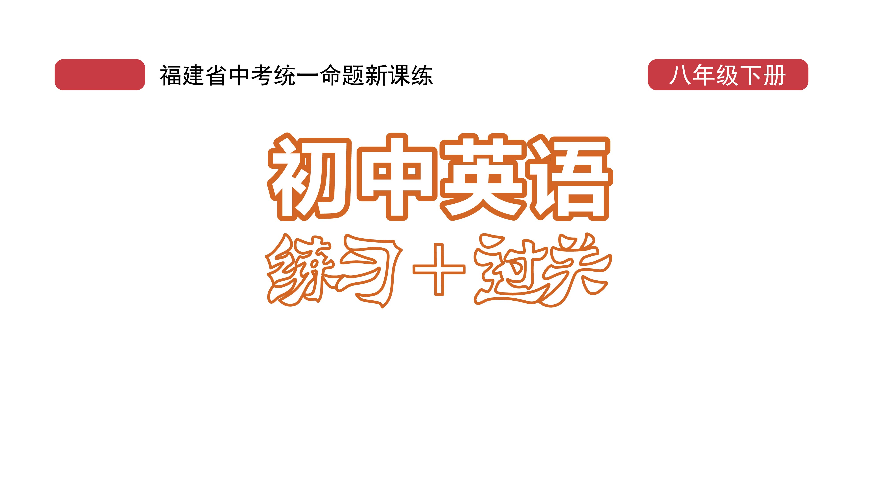
课时练习
期中复习六 模块八 第三章

Slide 2
一、根据语境、 音标或所给单词的提示完成句子， 每空一词。
1. It’s ___________ (tradition) for Chinese to eat mooncakes during the Mid-autumn Festival.
2. The leaking(泄露) of people’s __________ (person) information is against the law(法律).
3. Everyone ________ /ɪk'sept/ me went to the concert last night.
traditional
personal
except

Slide 3
一、根据语境、 音标或所给单词的提示完成句子， 每空一词。
4. Their _________ /'mærɪdʒ/ ceremony(典礼) was performed in the park.
5. As we know, there are fifty-five _________ in China.
marriage
minorities

Slide 4
二、 重点句型。
1. 明天那里会有另一场时装表演。
There will _________________________________ there tomorrow.
2. 它是中国妇女穿的一种传统裙子，现正在高级时装领域内逐渐流行起来。
It’s a ___________ dress for Chinese women, and it’s __________________ in the world of _______________.
be another fashion show
traditional
becoming popular
high fashion

Slide 5
二、 重点句型。
3. 唐装是在汉、唐时期中国开始闻名于世时得名的。
The Tang costume __________________ when China _______________________other countries during the Han and Tang Dynasties.
4. 现在人们可以把唐装设计成正装或者休闲装。
Today people can ______________ the Tang costume _____________________________________________.
got its name
became known to
design
as either formal or casual clothes

Slide 6
二、 重点句型。
5. 传统旗袍是由丝绸制成的。
The __________ cheongsam ____________________.
traditional was made of silk

Slide 7
三、重点语法。
★宾语从句Ⅳ
(A)根据所学知识，将横线上的内容补充完整。
1. 在含有宾语从句的复合句中，当主句为一般现在时态时，宾语从句的时态可以根据需要选用各种时态；当主句为一般过去时态时，宾语从句则使用相应的 ________ 时态。如：
He says he likes playing basketball.
He said he liked playing basketball.
过去

Slide 8
三、重点语法。
2. 当宾语从句叙述客观真理或客观事实时，即使主句为一般过去时态，从句仍然用 _________ 时态。如：Mr. Green told us that light travels faster than sound.
一般现在

Slide 9
三、重点语法。
(B)根据中文提示完成句子。 (每条横线不限词数。)
1. 我想知道那个小孩正在吃什么。
I want to know ___________________________ now.
2. 你知道Matt昨天这个时候在做什么吗？
Did you know ______________________ at this time yesterday?
what the child is eating
what Matt was doing

Slide 10
三、重点语法。
(B)根据中文提示完成句子。 (每条横线不限词数。)
3. 老师想知道Tony是否完成了家庭作业。
The teacher wanted to know if Tony ______________
_____________________________________________.
4. 我们不知道李先生是怎么到达动物园的。
We didn’t know ________________________ the zoo.
finished (doing) his homework
how Mr. Li got to

Slide 11
三、重点语法。
(B)根据中文提示完成句子。 (每条横线不限词数。)
5. Bob问我学校什么时候举办美食节。
Bob asked me __________________________________
______________________________________________.
when our school would hold/have the food festival

Slide 12
四、单项选择。
( )1. Chen Yifei is famous ________ his oil paintings, and he is known ________ many people across the world.
A. for; to B. as; to C. for; as
A

Slide 13
四、单项选择。
( )2. —Can you finish the task in five days?
—No, I need ___________ days.
A. another two B. two another C. more two
A

Slide 14
四、单项选择。
( )3. There’s only one ticket. Either you or Jim ___________ able to see the film.
A. are B. was C. is
C

Slide 15
四、单项选择。
( )4. —Physics is difficult and boring and I
don’t like it at all.
—I’m afraid you have no ________. You
have to learn it well if you want to be a
physicist.
A. condition B. choice C. decision
B

Slide 16
四、单项选择。
( )5. — _____________________________
—I don’t like it at all. It looks ugly on me.
A. What do you like the skirt?
B. What do you think of the skirt?
C. How do you think of the skirt?
B

Slide 17
四、单项选择。
( )6. Qian Xuesen returned to China in 1955, and ________, China began to develop its missile(导弹) and space industry(工业).
A. from then on B. from now on C. from time to time
A

Slide 18
四、单项选择。
( )7. —Why did you draw so many flowers and
stars?
—Tomorrow is Mother’s Day. I want to
_______ my thanks to my mother.
A. receive B. express C. have
B

Slide 19
四、单项选择。
( )8. __________, China was weak, but now it’s much stronger.
A. Anytime B. At one time C. In time
B

Slide 20
四、单项选择。
( )9. The color yellow ____________ power and prosperity(繁荣) in Chinese culture.
A. stands up B. builds up C. stands for
C

Slide 21
四、单项选择。
( )10. Joanna said that she ________ a book when I called her.
A. was reading B. reads C. read
A

Slide 22
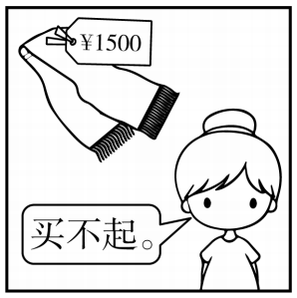
五、看图写话。
1. so … that, afford
The scarf is so expensive that the girl can’t afford it./
The scarf was so expensive that she couldn’t afford it.

Slide 23
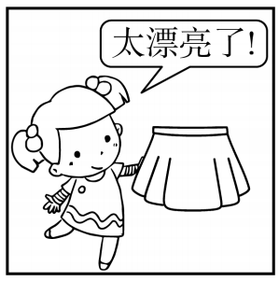
五、看图写话。
2. say
The girl/She said the skirt was very beautiful/nice.

Slide 24
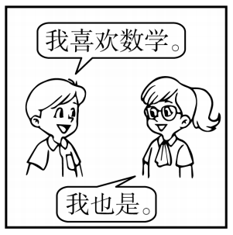
五、看图写话。
3. both, like
Both the girl and the boy like math./
Both of them/They both like math.

Slide 25
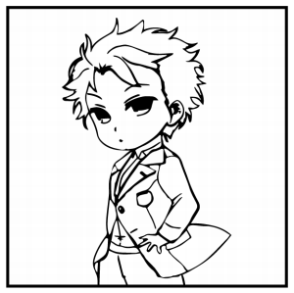
五、看图写话。
4. look, coat
The boy/He looks handsome in the coat.

Slide 26
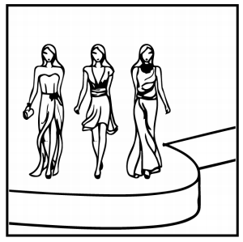
五、看图写话。
5. there be, tomorrow
There will/is going to be a fashion show tomorrow.

Slide 27
六、情景交际。
1. 你想知道对方最喜欢的电影类型, 可以这样问：
_____________________________________________?
2. 你想知道足球比赛开始的时间, 可以这样问朋友：
Do you know _________________________________?
3. 你想知道朋友新夹克衫的购买地点, 可以这样问他：
Could you please tell me ________________________
_____________________________________________?
What kind of movie do you like best
when the football game starts/will start
where you bought your new jacket

Slide 28
六、情景交际。
4. 你想知道对方昨天和谁一起去野餐, 可以这样问：
____________________________________________?
5. 你想建议大家明天下午两点在校门口见面, 可以这样说：
Shall we _____________________________________
_____________________________________________?
Who/Whom did you go for a picnic with yesterday
meet at the school gate at 2:00 tomorrow afternoon

Slide 29
七、短文填空。
Some only children need to spend a lot of time looking after a parent who is sick or disabled(残疾的). If you are in this situation(情况), then you are not 1 /ə'ləʊn/. There are millions of children who are in this situation. Some only children feel worried 2 they don’t know how to look after others. Are you one of the only children? If your answer is “yes”, just read on.
alone
because

Slide 30
七、短文填空。
The most important thing is to get help. You can try some ways to 3 for help. There are different ways. One of them is to search for 4 /ˌɪnfə(r)'meɪʃn/ on the Internet. I have 5 good website for you. You can visit it at any time. The website is www.youngcarers.net.
ask
information
a

Slide 31
七、短文填空。
When you visit the website, you can find some 6 (use) knowledge. It teaches you how to look after the person you are 7 (care) for. Of course, you can also learn how to look after 8 (you). What’s more, you can read stories about other kids who have the same experience as you.
useful
caring
yourself

Slide 32
七、短文填空。
The website 9 (provide) a phone number. If you would like to talk to someone who can 10 /ˌʌndə'stænd/ you, pick up your phone and dial the number.
provides
understand

Slide 33
八、阅读理解。
New research(研究) shows that people who read a lot live longer. 1 The researchers also said that books helped the brain(大脑) more than newspapers and magazines. Even reading for half an hour a day could help us to live longer. In the study, researchers looked at the lifestyles of 3,500 men and women over a 12-year period. 2 All of the people were at least 50 years old at the start of the research.

Slide 34
八、阅读理解。
3 It found that people who read for almost 3.5 hours a week were 17% less likely (可能的) to die than those who read no books. 4 Researcher Becea Levy said, “Older people, regardless of (不管) health, wealth or education, showed the advantage of reading books.”

Slide 35
八、阅读理解。
5 Becea said, “People over the age of 65 spent 4.4 hours per day watching television. Spending time reading books could be more helpful to their health.”

Slide 36
九、阅读理解。
A. The research was in the magazine (杂志)Social
Science and Medicine.
B. She told people to change watching TV for reading to
live longer.
C. They also looked at their reading habits, health and
their education background.
D. And those who read for more than 3.5 hours a week
were 23% less likely to die.
E. The researchers said reading kept the mind active and
made us take better care of our health.
1. _____ 2. _____ 3. _____ 4. _____ 5. _____
E C A D B

Slide 37


